Slide 1
Music Player
Submitted By Name: Hassan Ahmed Turzo ID: 202010005 Course Name: OOP (CSE-2312) Section: A Batch: 63th
Submitted To MD.Shamimul Islam Shamim Lecturer: Department of CSE

Slide 2
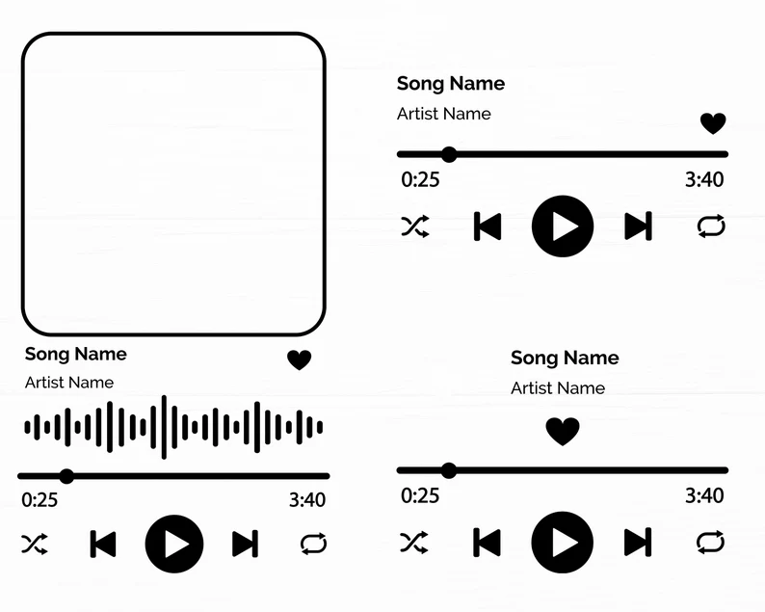
OVERVIEW
The Music Player project is a simple application designed to help users manage and play their music collections. It organizes songs, albums, and playlists, making it easy to access and enjoy music.
Key Features
1. Manage Songs
2. Organize Albums
3. Create Playlists
4. Play Music
5. User-Friendly Interface

Slide 3
Project Structure
Song Class: Represents a song with attributes such as title, artist, and duration.
Album Class: Represents an album containing a collection of songs.
Playlist Class: Represents a playlist containing a collection of songs.
MusicPlayer Class: Manages songs, albums, playlists, and controls the playback of songs.

Slide 4
APPLICATION Working Process
Initialization: The application starts by creating instances of the MusicPlayer class, which will manage all songs, albums, and playlists.
Adding Songs: Users can create Song objects by providing the title, artist, and duration of each song. These songs are then added to the music player's song collection.
Creating Albums: Users can create Album objects by providing the album title and artist. Songs can be added to albums to group them together.

Slide 5
APPLICATION Working Process
Creating Playlists: Users can create Playlist objects with a specific name. Songs can be added or removed from playlists, allowing users to curate custom playlists for different moods or occasions.
Listing Content: The music player can list all songs, albums, and playlists, displaying detailed information about each item and its contents.
Playing Songs: Users can play any song in the music player's collection. The current implementation simulates playing by printing the song's details to the console.

Slide 6
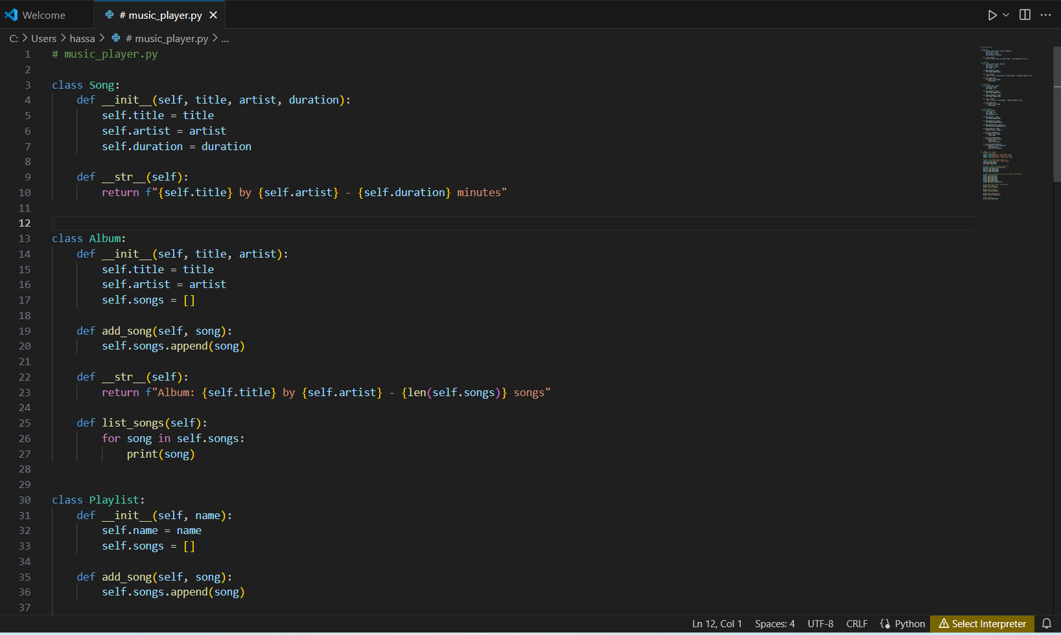

Slide 7
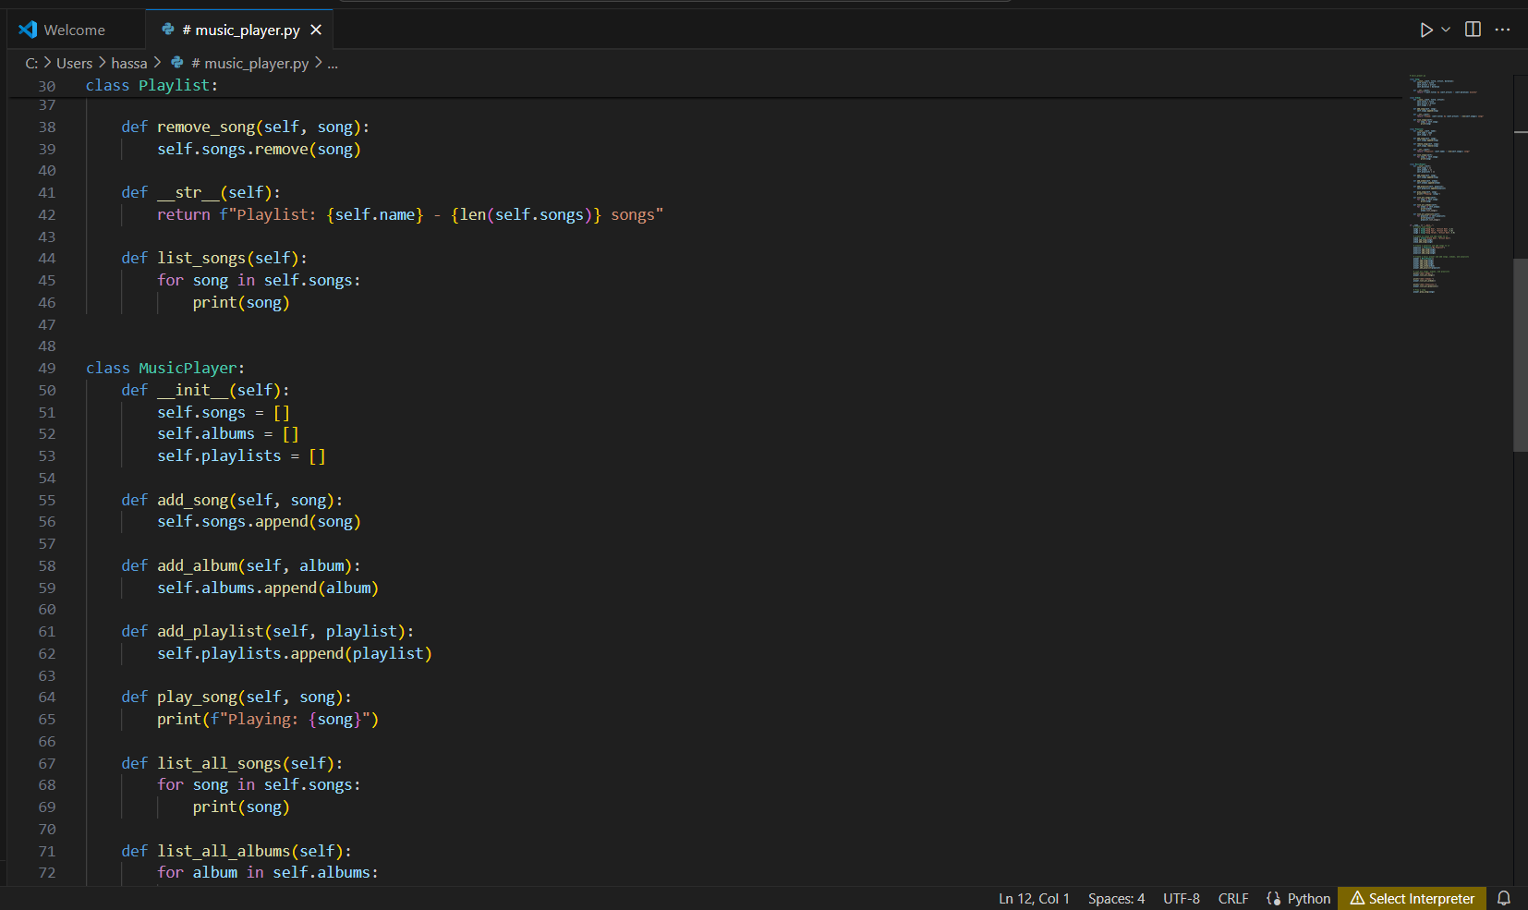

Slide 8
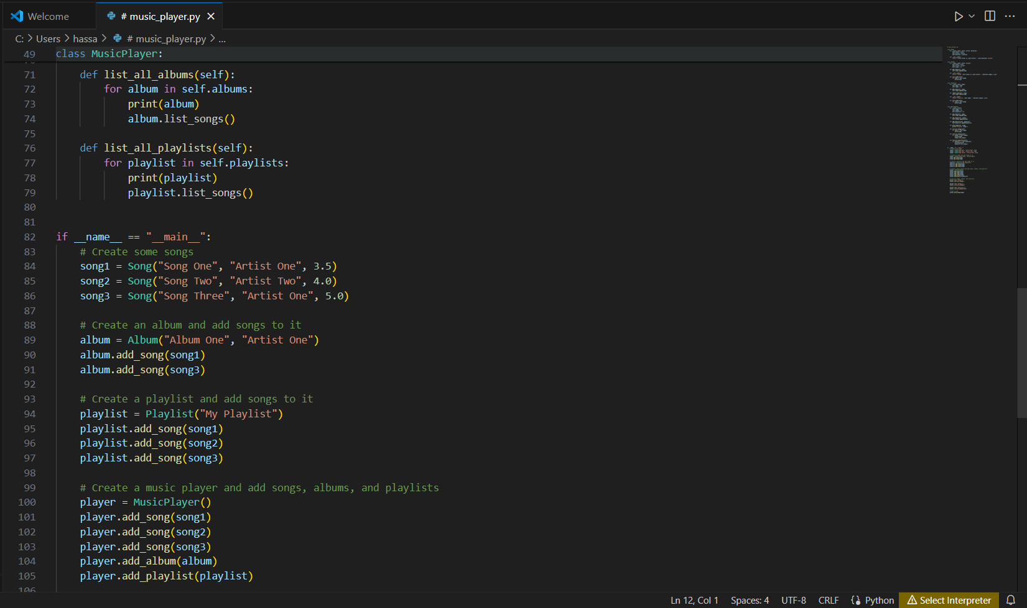

Slide 9
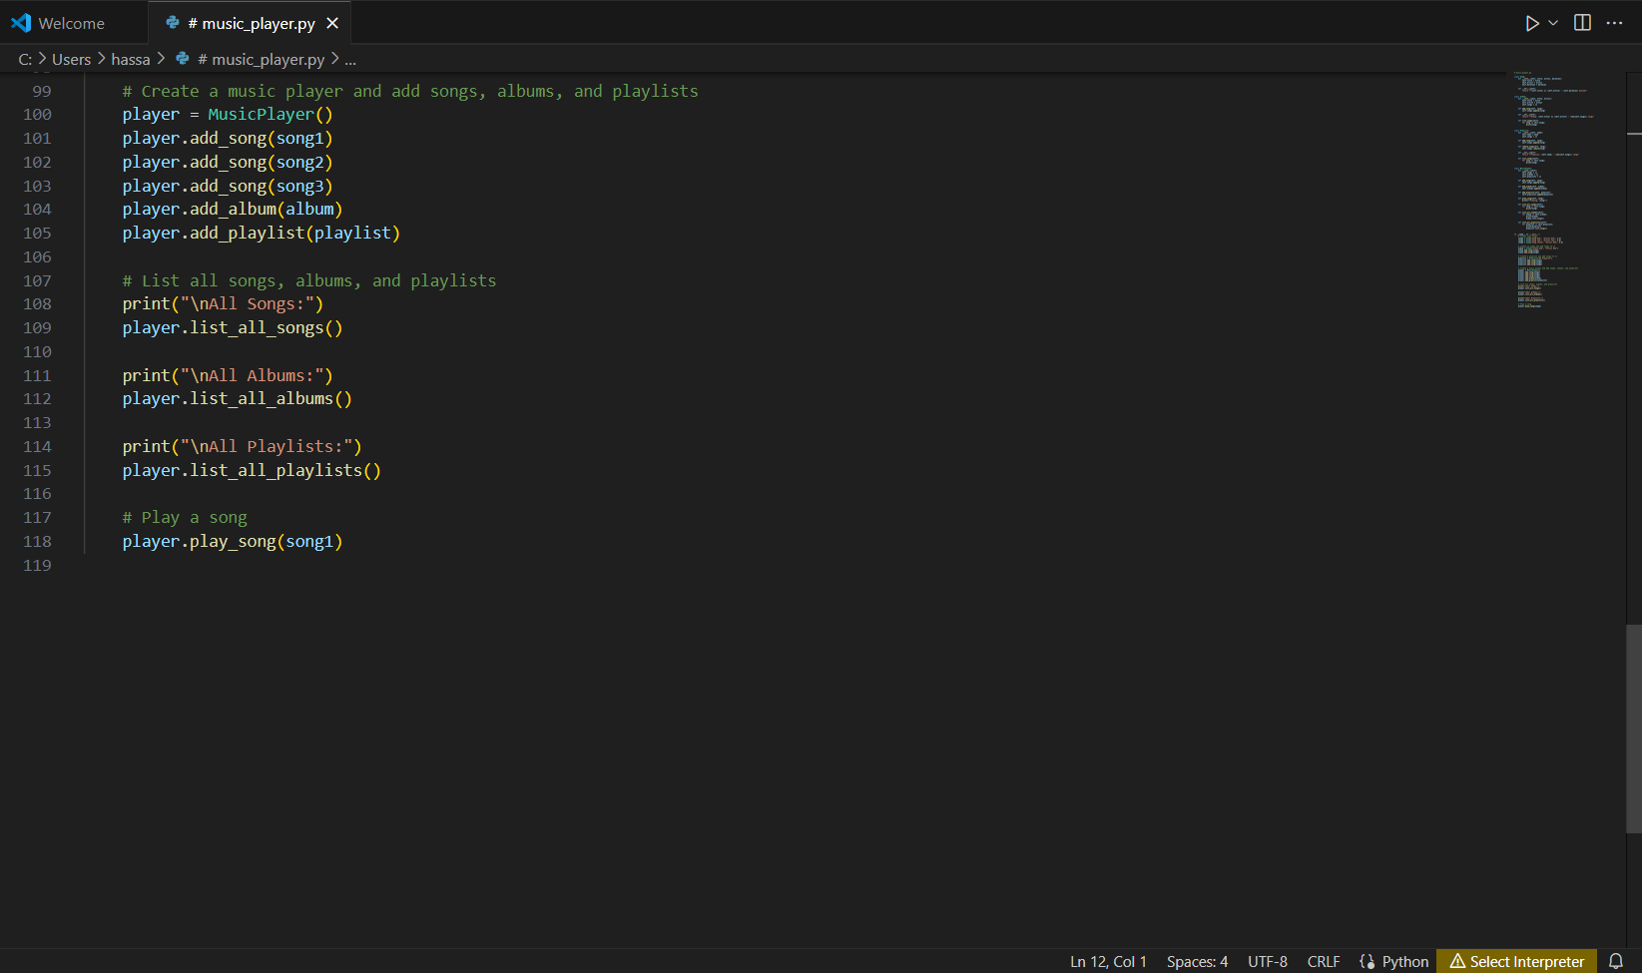

Slide 10
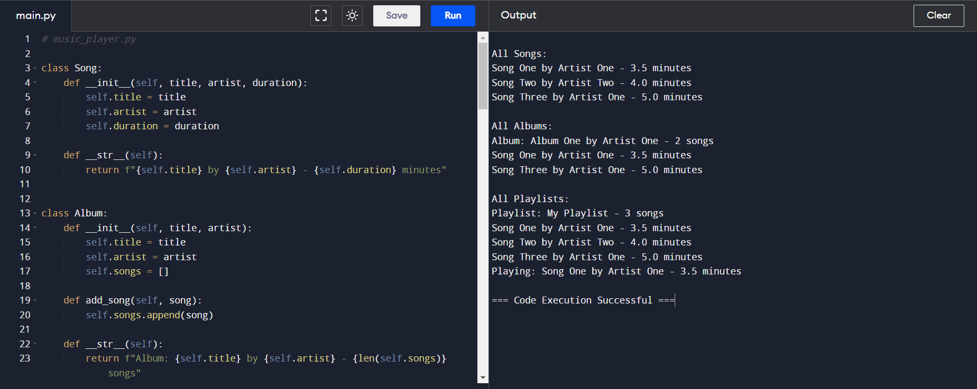

Slide 11
Conclusion
The Music Player project successfully demonstrates how to organize and manage multimedia content using object-oriented programming. By breaking down the functionality into distinct classes for songs, albums, and playlists, the project provides a clear and modular structure that is easy to understand and extend. Users can create and manage their music collections, organize songs into albums and playlists, and simulate playing songs. This foundational project can be further expanded with additional features such as real audio playback, advanced search and filter options, and a graphical user interface for an enhanced user experience.

Slide 12
Thank You
Name: Hassan Ahmed Turzo ID: 202010005

